Slide 1

Lesson 6 CN4005:
Presentation skills 1
Dr Fadi Safieddine
1
Dr. Fadi Safieddine copyright 2024

Slide 2
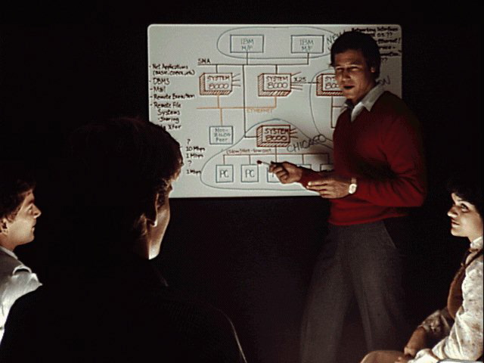
Why do you need presentation skills?
Job Interviews
Education
Employment
Personal development:
Conquering your fear.
Building confidence.

Slide 3
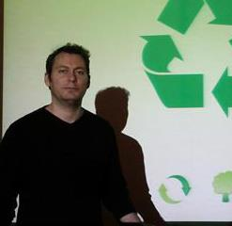
What are we doing today?
My experience is that telling students their mistakes doesn’t help.
Showing them how not to present helps.
I’ll present some of the common mistakes, and you be given a chance to guess the problems.
I’ll be presenting nine common problems.

Slide 4

Are you ready for problem 1?

Slide 5
Problem Number 1:
Security:
Is the protection of personal or organizational content.
It protects our privacy.
It costs companies lots of money.
Since 2002, researchers have been investigating better ways to improve our security.
Hackers have a variety of interests:
Financial gain
Just to impress us!

Slide 6
What is the problem?
What is the problem here?

Slide 7
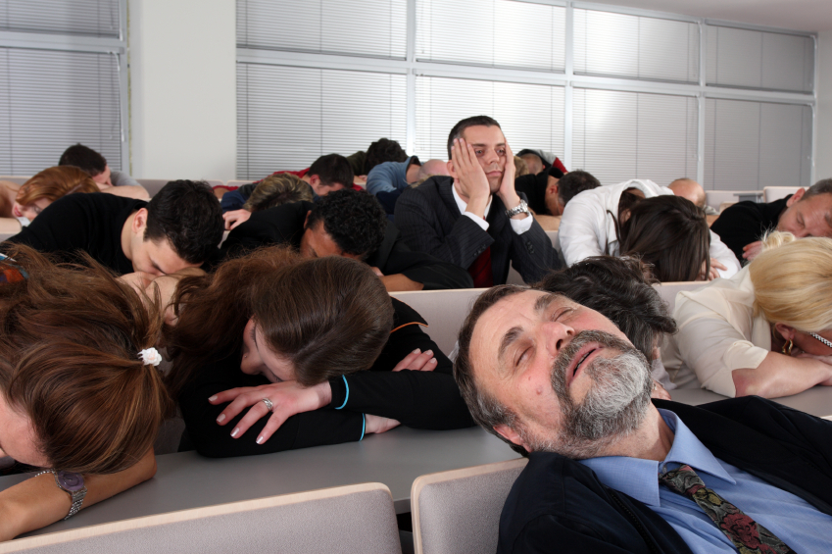
Answer to problem one:
Voice:
Low cannot be heard.
Monotonous (BORING).
& Talking to myself.
Lack of images, diagrams, or anything that can help convey the message.

Slide 8
Are you ready for problem 2?

Slide 9

Problem Number 2:
Security:
Is the protection of personal or organizational content.
It protects our privacy.
It costs companies lots of money.
Since 2002, researchers have been investigating better ways to improve our security.
Hackers have a variety of interests:
Financial gain
Just to impress us!

Slide 10
What is the problem two?
What is the problem you see in the first part?

Slide 11
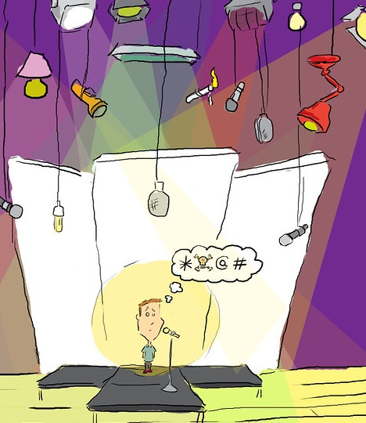
Answer to problem Two:
Body Language:
Eye contact
Outside
Laptop
At the wall
Looking at the slides
Looking nowhere.
Hands
Leg movement.
All these are signs of a lack of confidence.

Slide 12
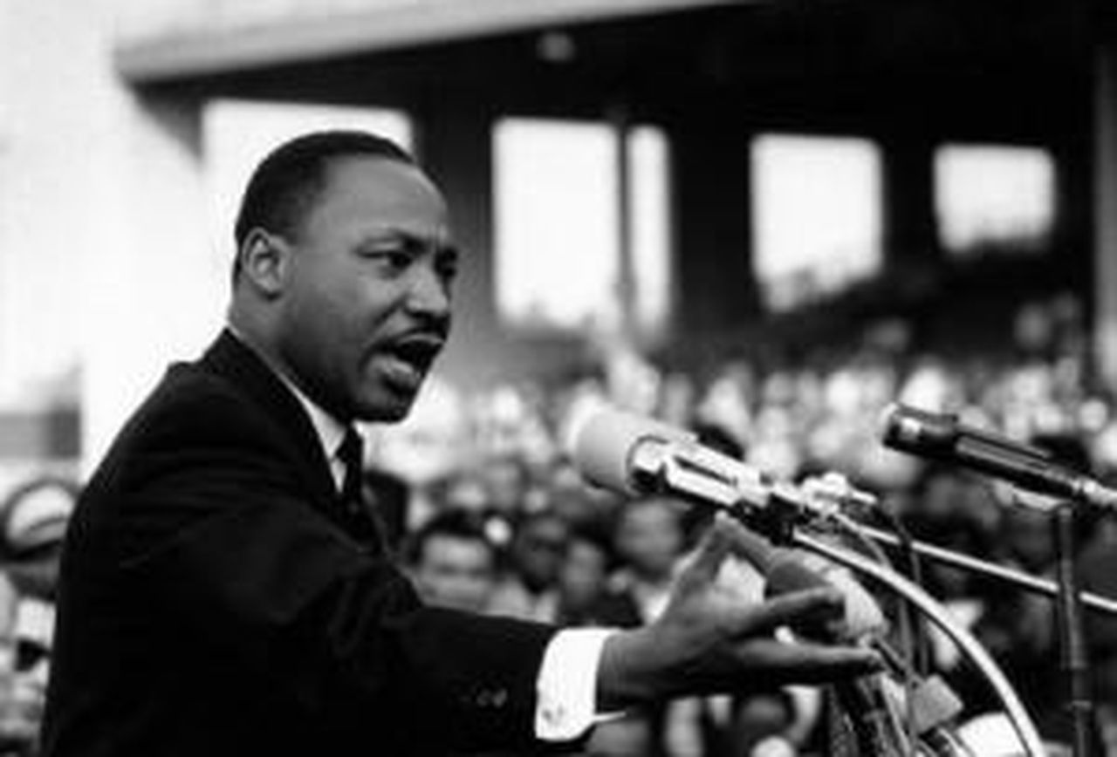
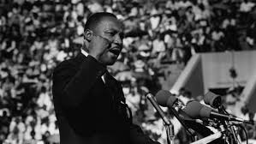
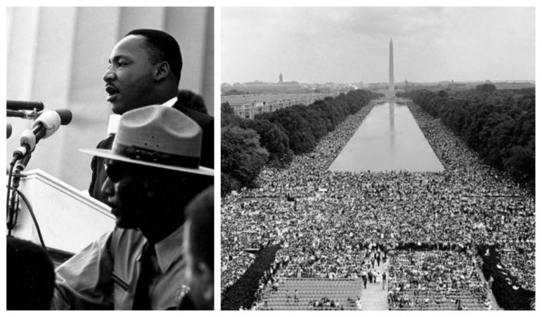
Eye contact

Slide 13
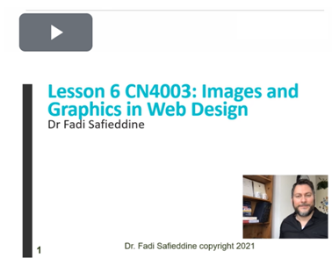
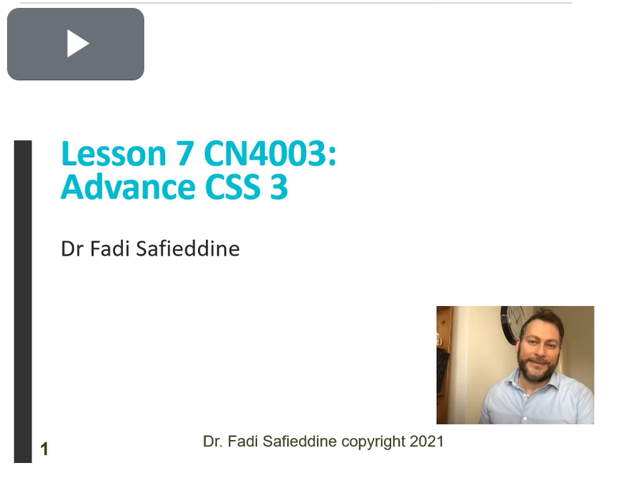
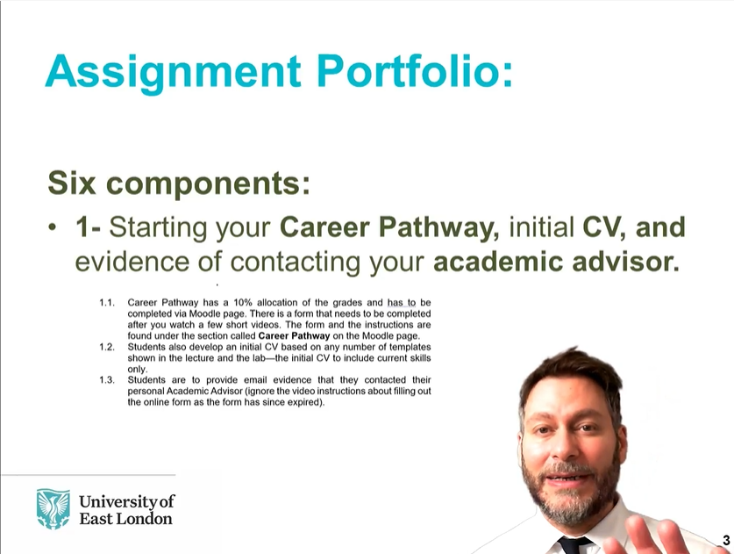
Eye contact, even online!

Slide 14
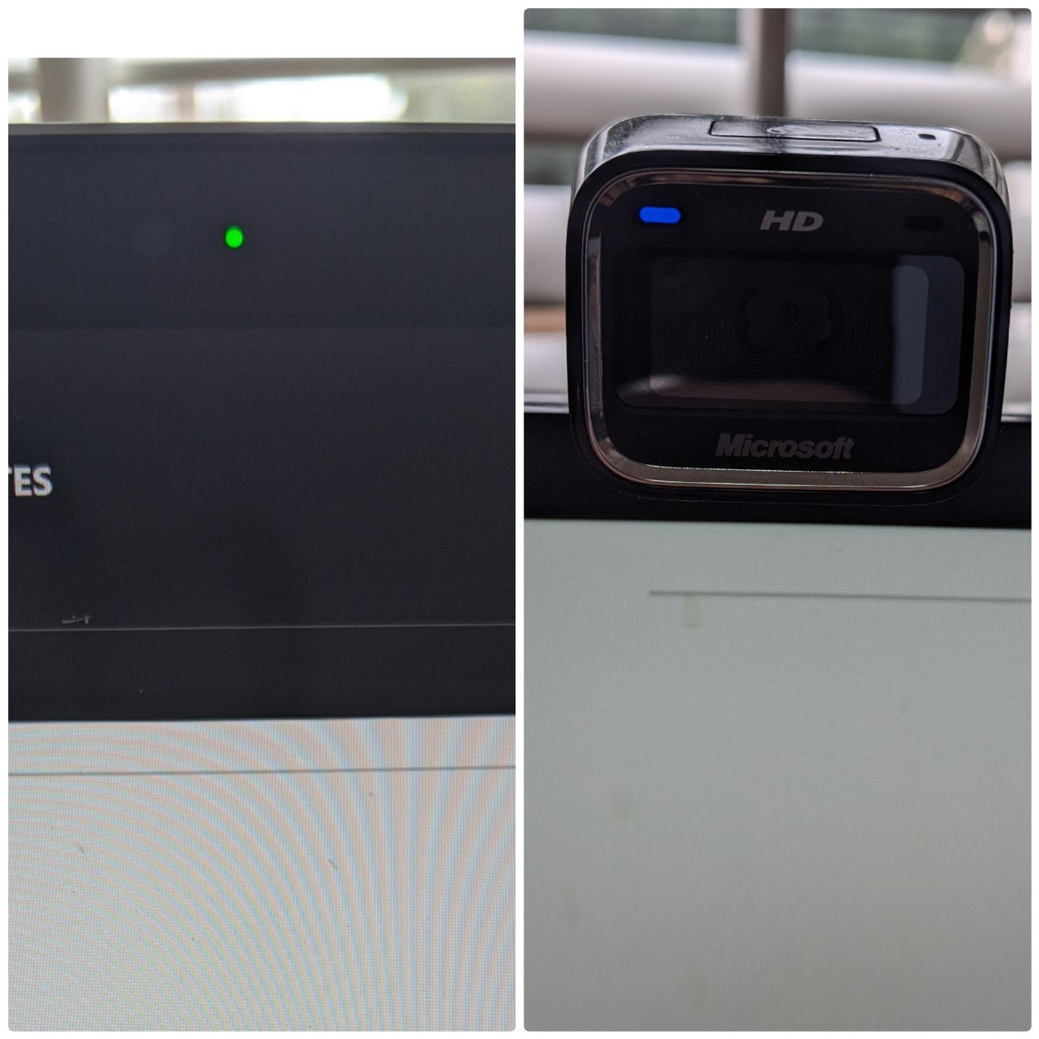

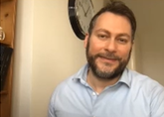
Eye contact

Slide 15
Are you ready for problem 3?

Slide 16
Problem Number 3:
Security
In 2002, several computer companies realized the need for designing system security policy. The intention was to develop a clear strategy that would tackle all sorts of problems. It starts by looking at the physical threats such as fire, earthquake, floods, and burglary. The solution is to device a plan that the management and employee are asked to get involved in. This would be by training management on performing periodical backups. This would work by performing a full electronic backup or print out of everything in the system. Also to train managers on doing periodical check up to the system against possible threats, such as…..

Slide 17
What is the problem three?
Activity 3. What is the problem here?

Slide 18

Answer to Problem Three:
Use bullet points
Don’t read, but rather explain or expand.
The notes are here to guide you!
& Referencing your work.

Slide 19
Mitigating Risks:
In early 2000, companies started taking Security policies more seriously (Simon, 2002).
Physical Threats:
Fire
Earthquake
Floods
Burglary
Strategies he recommended:
Backup
Training

Slide 20
Are you ready for problem 4?

Slide 21
Problem Number 4:
Security:
Is the protection of personal or organizational content.
It protects our privacy.
It costs companies lots of money.
Since 2002, researchers have been investigating better ways to improve our security.
Hackers have a variety of interests:
Financial gain
Just to impress us!

Slide 22
What is the problem four?
What is the problem here?

Slide 23

Answer to Problem four:
Reading from a paper is not professional.
Use cards
Other extremes that are included under this category:
Talking forever on same slide.
Time sharing when presenting in groups!!!

Slide 24
Are you ready for problem 5?

Slide 25
Problem Number 5: Group Presentation
Security:
Is the protection of personal or organizational content.
It protects our privacy.
It costs companies lots of money.
Since 2002, researchers have been investigating better ways to improve our security.
Hackers have a variety of interests:
Financial gain
Just to impress us!

Slide 26
What is the problem five?
What is the problem here?

Slide 27
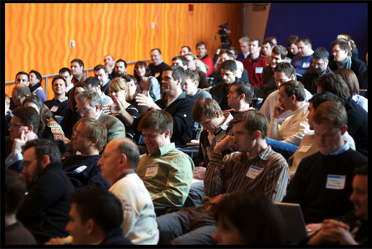
Answer to Problem five:
Taking turns in a group presentation.
Remember to include greetings to the audience.

Slide 28
Are you ready for problem 6?

Slide 29
Problem Number 6:
Security:
Is the fortification of subjective or organizational content.
It safeguards our privacy.
There is a high monetary costs linked to it.
Since 2002, researchers have been scrutinizing better ways for enhancement of our security.
Hackers have a diversity of interests:
Monetarist gain
Just to impress us!

Slide 30
What is the problem six?
Activity 6. What is the problem here?
Answer the question and come back for part 7.

Slide 31
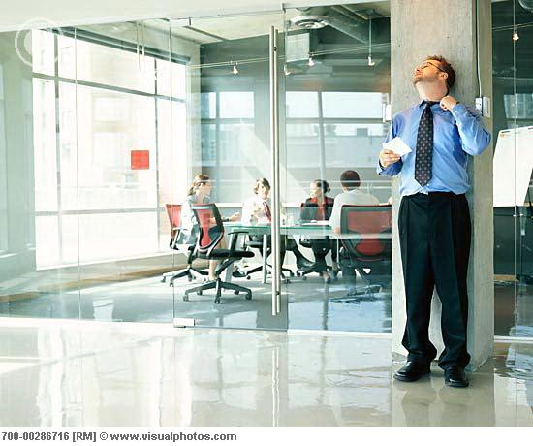
Answer to Problem six:
Rehearsing!!!
Using difficult words that I cannot pronounce right!
Using examples out of your head.
Repeating
Not remembering what to say
Not a presentation form of talking (like talking to your friends)

Slide 32
Are you ready for problem 7?

Slide 33
Problem Number 7
Security
Security:
It is important to protect the company.
It protects our privacy.
It cost company lots of money.
Hackers do it to impress us!
By Fadi Safieddine

Slide 34
What is the problem seven?
What is the problem here?

Slide 35
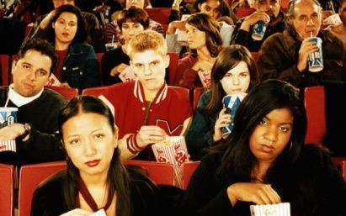
Answer to Problem Seven:
Animation!
Don’t over do it!
Remember the objectives of any presentation are:
To inform: Teach people something new?
To Persuade: Change people’s view.
To entertain: Keep people’s attention.

Slide 36
Are you ready for problem 8?

Slide 37
Mitigating Risks:
Steps in Risk Management:
Identification
Analysis of risk
Qualitative and Quantitative
Planning of measures
Monitoring and control
And this whole process relies on a good communication system in place that is central to the process.
All four steps work together, provided it is linked together right through good communication.

Slide 38
Problem 8
What is the issue here?

Slide 39
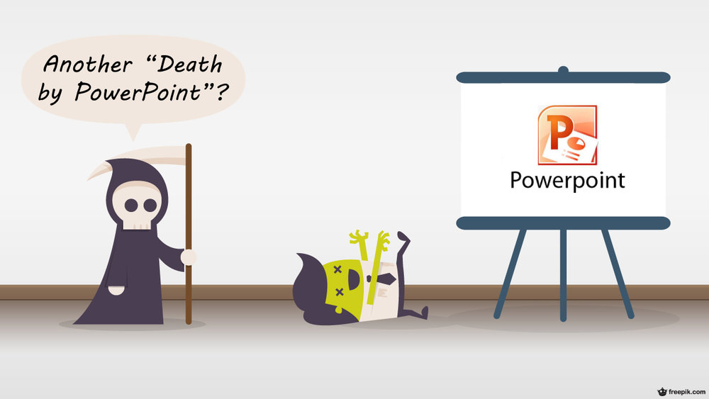
Death by PowerPoint!
When explaining a process, do not use bullet points
Why not put this in a diagram?

Slide 40
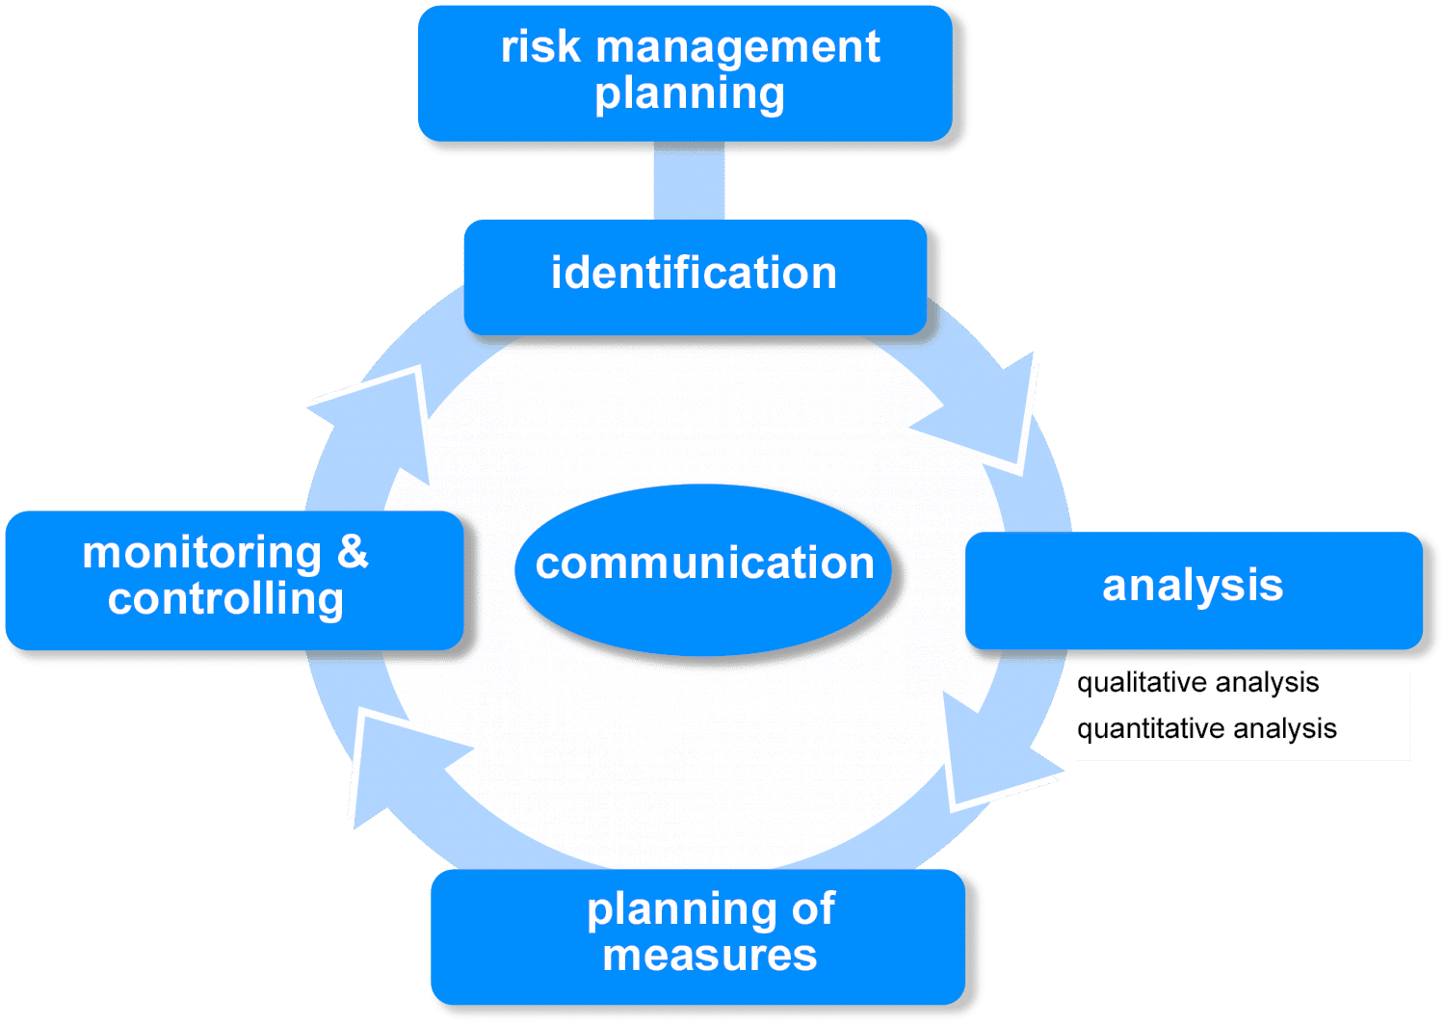
Mitigating Risks:

Slide 41
Mitigating Risks:

Slide 42
Mitigating Risks:

Slide 43
Mitigating Risks:

Slide 44
Mitigating Risks:

Slide 45
Mitigating Risks:

Slide 46
Mitigating Risks:

Slide 47

Are you ready for problem 9?

Slide 48
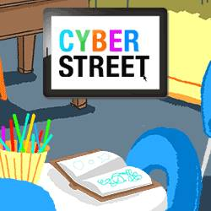
Problem Number 9:
Security:
Is the protection of personal or organizational content.
It protects our privacy.
It costs companies lots of money.
Since 2002, researchers have been investigating better ways to improve our security.
Hackers have a variety of interests:
Financial gain
Just to impress us

Slide 49
What is the problem nine?
What is the problem here?

Slide 50
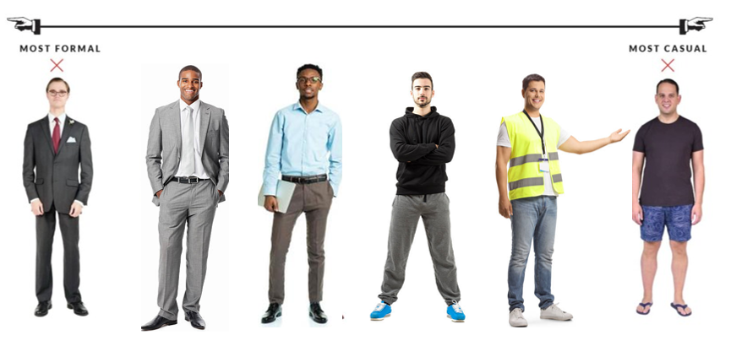
Dress code for a presentation:

Slide 51
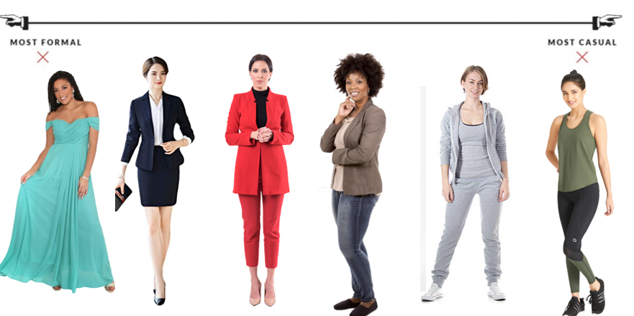
Dress code for a presentation:

Slide 52
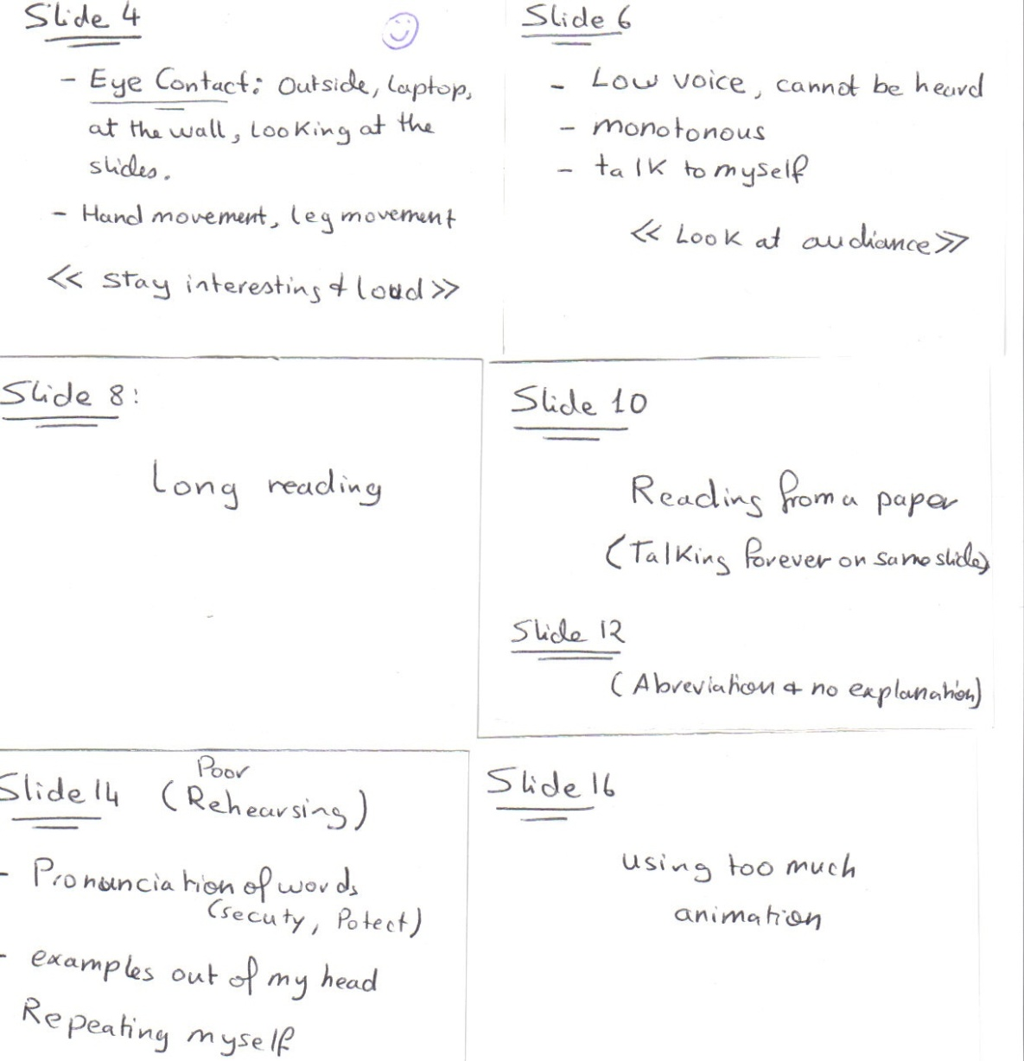
Example of Reading cards
Notice:
Emphasis on smile to start the lecture.
Notes on content as well as delivery
You can point out examples you want to focus on and references.
Remember not to use these a reading points

Slide 53
How to practice?
Design your presentation to be:
Persuasive
Informative
Entertaining
For lectures, I plan them to be: 20%, 70%, and 10%.
Have a balance:
Did you notice how my lectures are structured?
This is important for your assignment.
This is an important skill.
Then the content….
Include interactivity with some of the questions, animations, and images.

Slide 54
How to practice?
Key points:
Be loud and project your voice.
Maintain eye contact and flow movement.
Do not read from the slides!
Do not read from a paper or phone.
Rehearse your presentation many times!
Do not overdo the animation.
When presenting in groups, rehearse and agree to take turns.
Dress for the occasion
Bring a drink with you!
All the best of luck!

